Slide 1

The changing role of fishes on coral reefs:
an evolutionary perspective
David Bellwood, Peter Cowman & Christopher Goatley
School of Marine and Tropical Biology, James Cook University

Slide 2
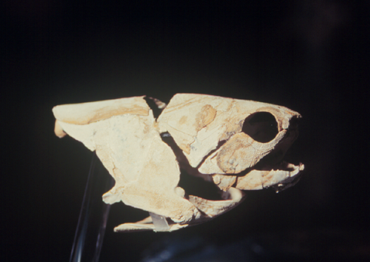
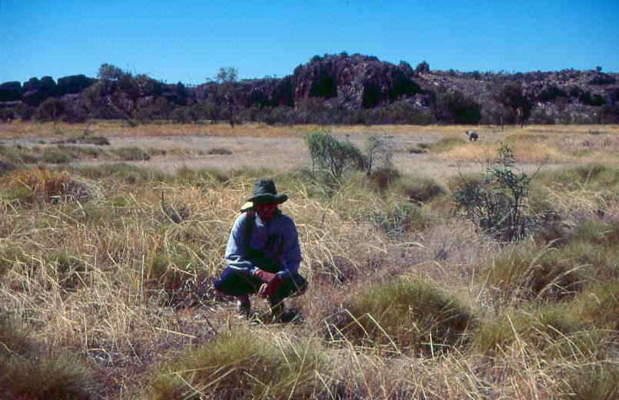
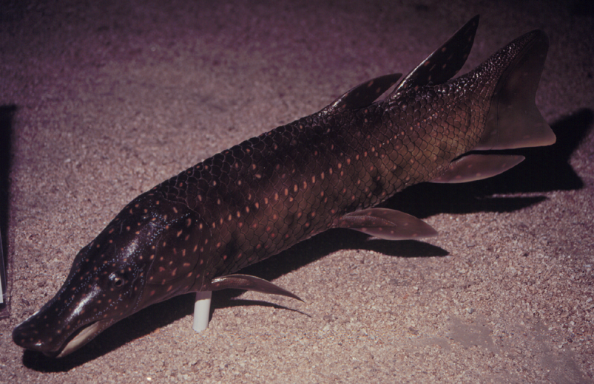
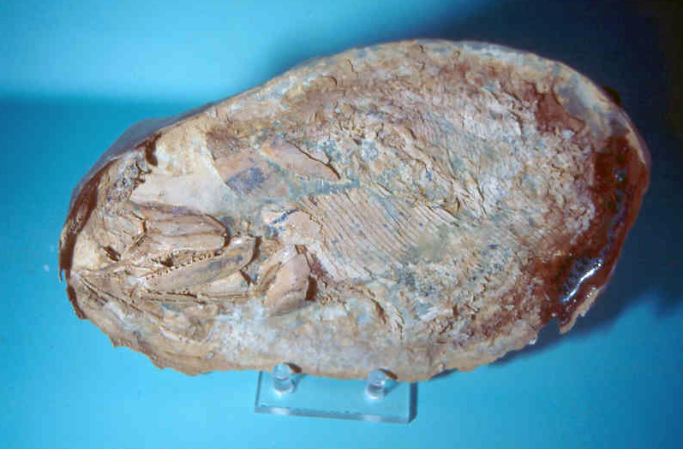
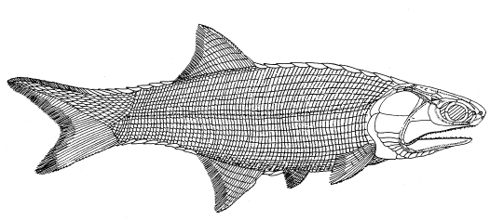
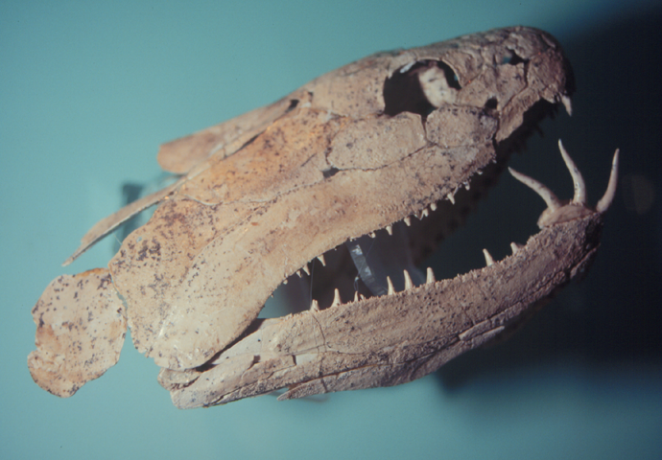
Mimia – Basal Actinopterygian
Gogo – Devonian 380 MY
400 MY
200 MY
100 MY
0

Slide 3
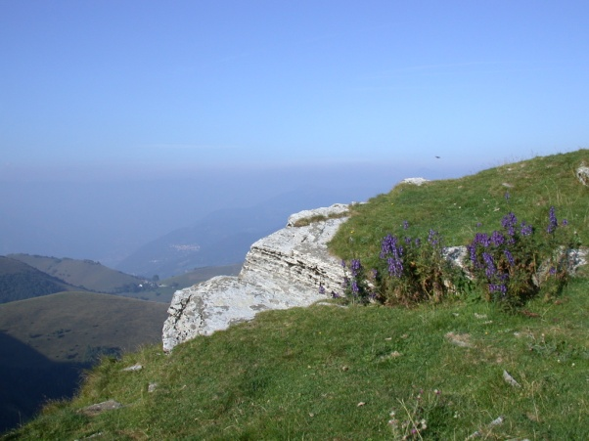
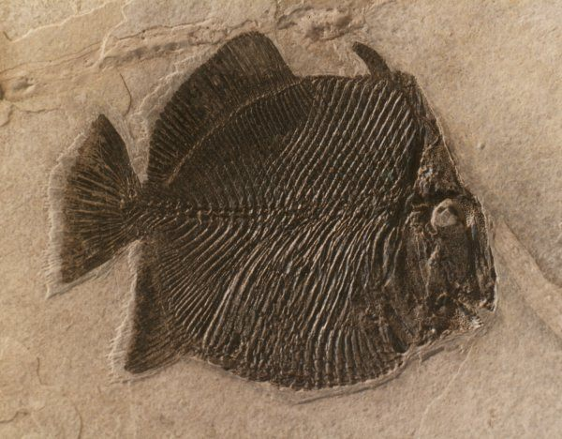
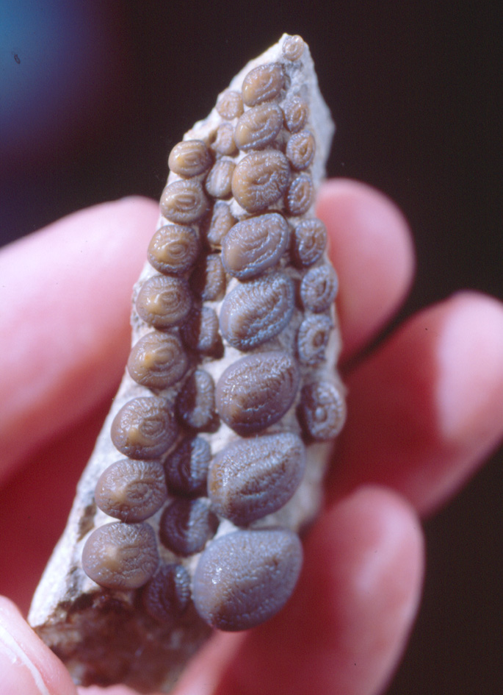
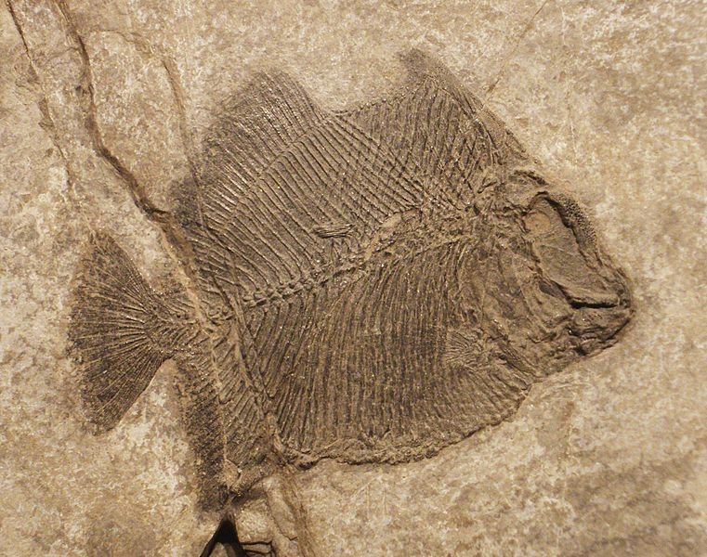
Brembodus
Mimia
400 MY
200 MY
100 MY
0

Slide 4
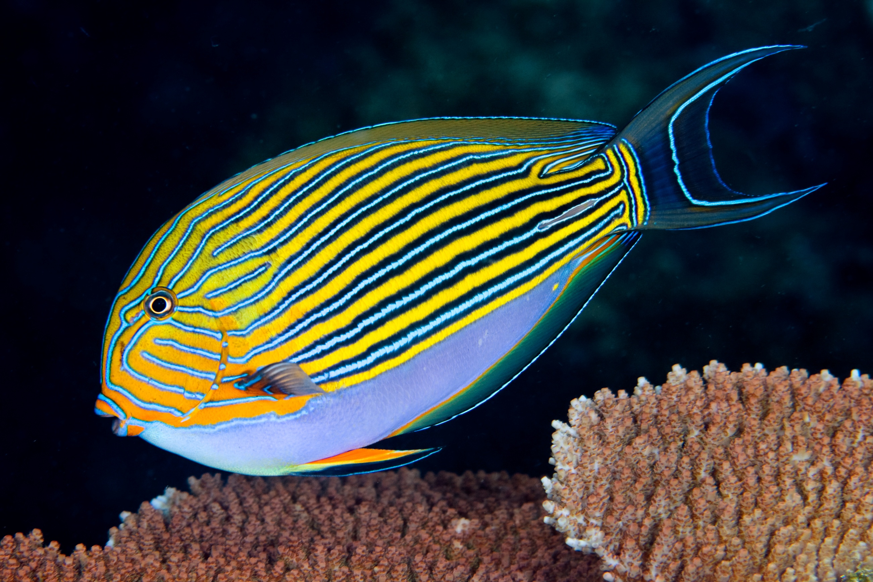

Slide 5
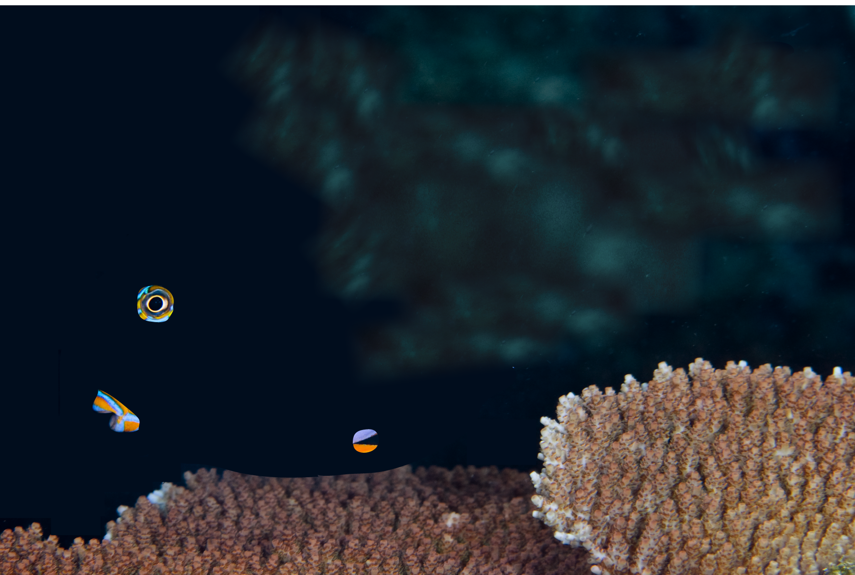

Slide 7
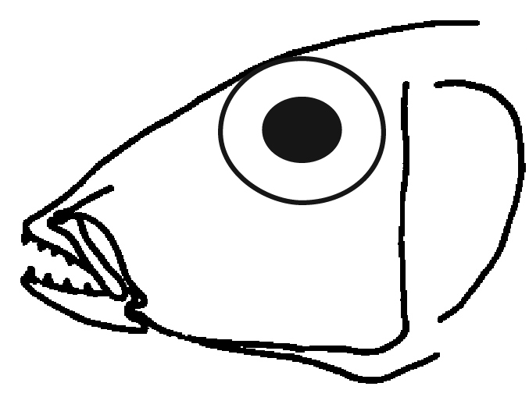
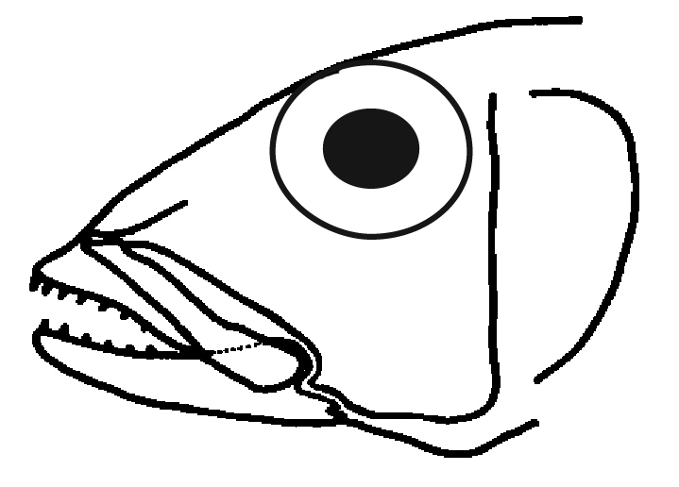
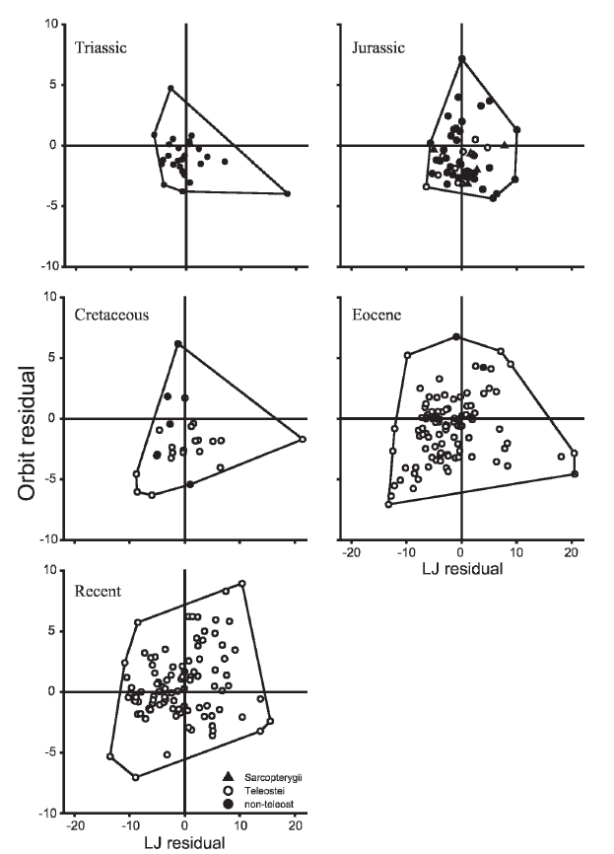
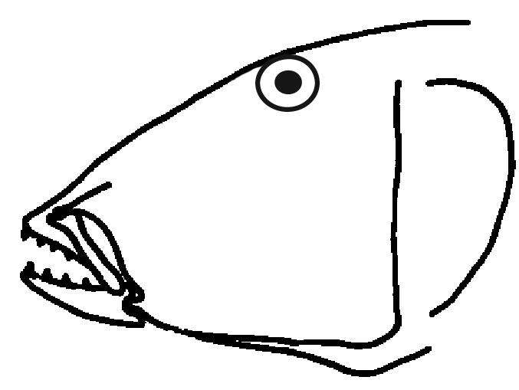
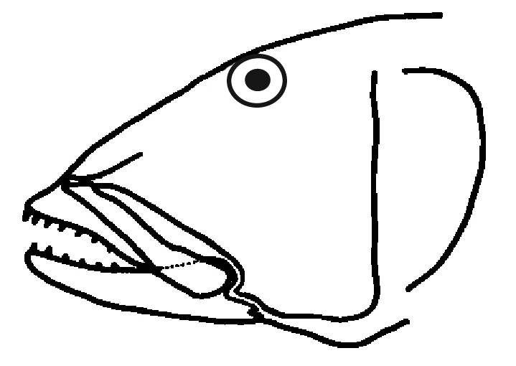
Eye
Mouth

Slide 8
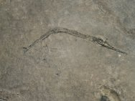
Brembodus
Eye
Saurichthys
Mouth
Goatley, et al. 2010 Paleobiology

Slide 12
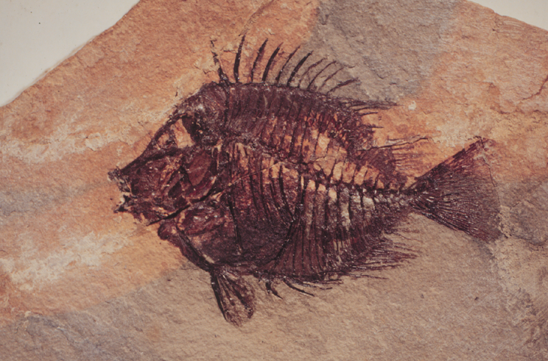
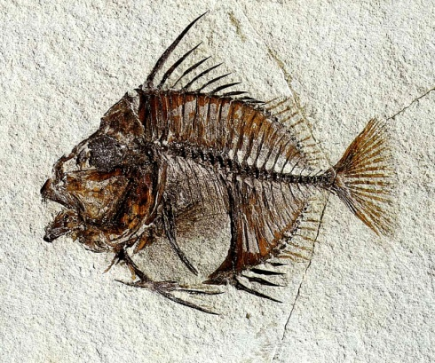
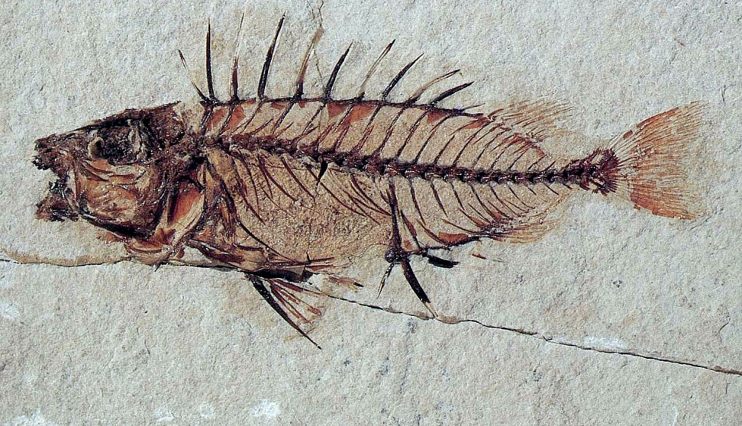
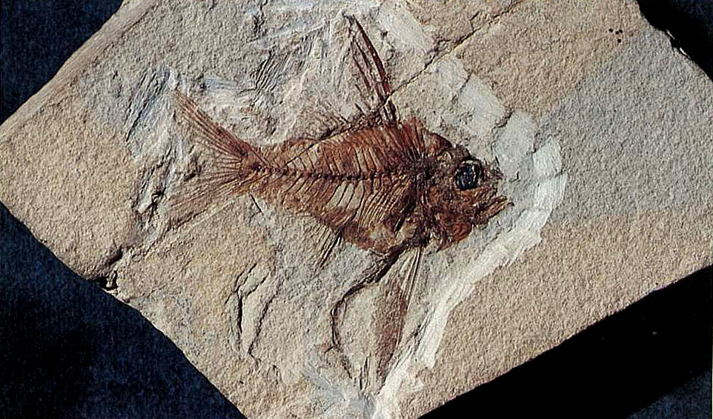
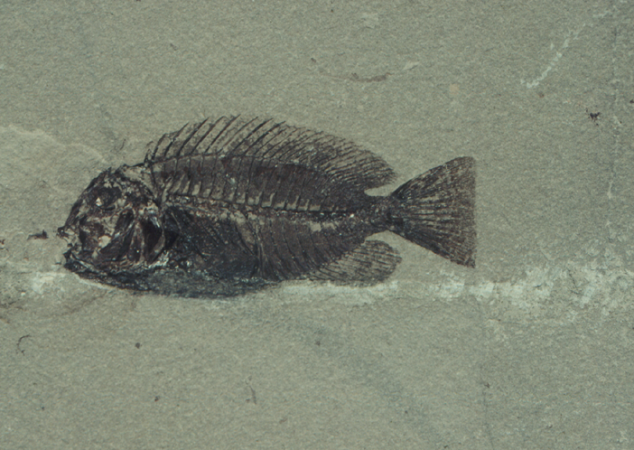
Apogonidae
Nocturnal
feeding
High-precision
Diurnal feeding
Goatley, et al. 2010 Paleobiology

Slide 13
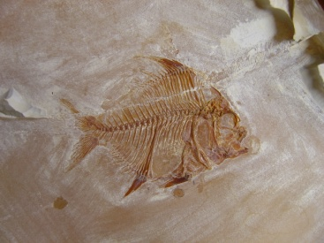
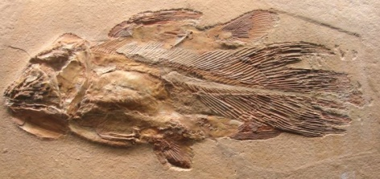
Devonian
Triassic
Jurassic
Cretaceous
Eocene
Brembodus
Gigapteryx
Eorandalllia
Libys
Mimia
K/T
400 MY
200 MY
100 MY
0

Slide 14
Devonian
Triassic
Jurassic
Cretaceous
Eocene
Brembodus
Gigapteryx
Eorandalllia
Libys
Mimia
K/T
400 MY
200 MY
100 MY
0

Slide 15
Devonian
Triassic
Jurassic
Cretaceous
Eocene
Brembodus
Gigapteryx
Eorandalllia
Libys
Mimia
K/T
400 MY
200 MY
100 MY
0

Slide 16
Devonian
Triassic
Jurassic
Cretaceous
Eocene
Brembodus
Gigapteryx
Eorandalllia
Libys
Mimia
K/T
400 MY
200 MY
100 MY
0

Slide 17
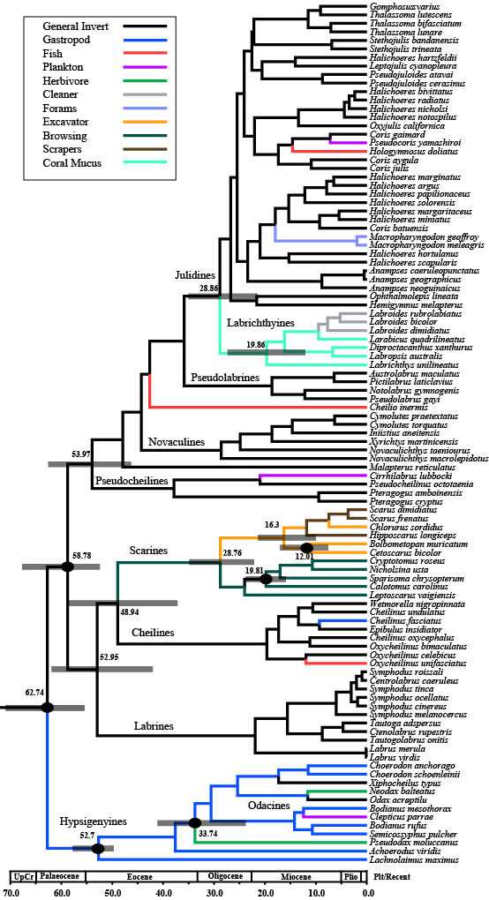
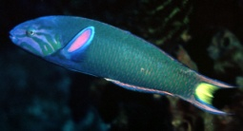
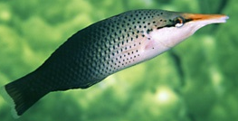
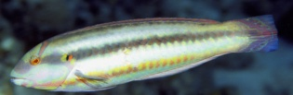
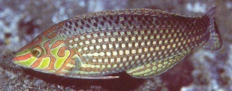
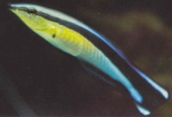
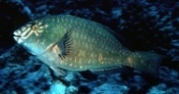
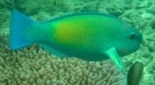
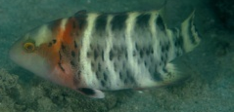
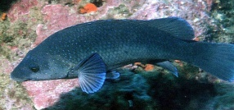
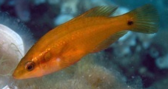
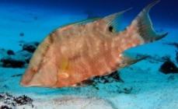
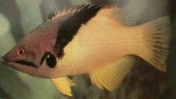
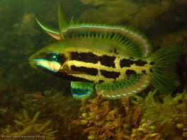
Thalassoma/Gomphosus
NW Halichoeres
OW Halichoeres
Labrichthyines
Cleaner wrasse
Novaculines: Razorfish
Scarines
Parrotfishes
Cheilines
Labrines
Hypsigenyines
Tuskfish, Hogfish,
Odacids
Notes:
Results
Phylogenetic tree: monophyly of the Labridae & Hierarchy of Labrid tribes. Nothing new
Supports published topologies with sereval monophyletic tribes. Basal HYPSIGENYINES, LABRINES, SCARINES AND CHELINES. Minor tribes.
Crown group Julidines with Para/polyphyletic genera.
Topology and Branch lengths used in age estimation.

Slide 18
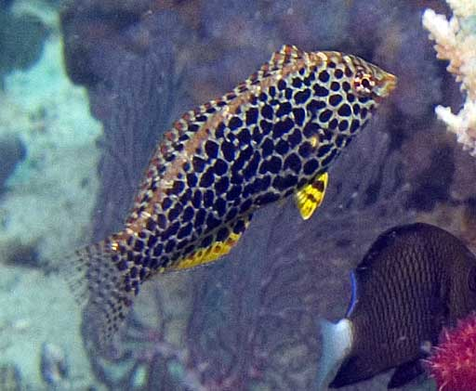
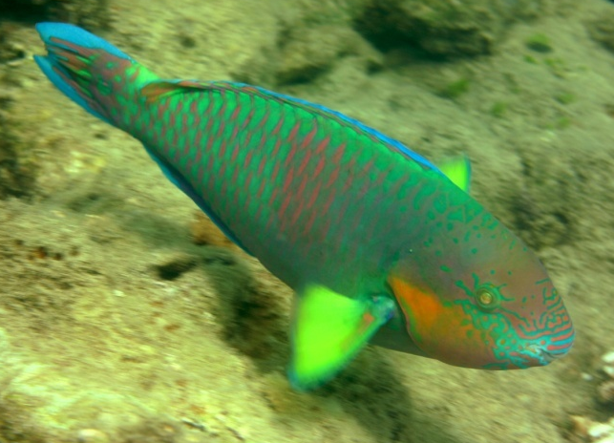
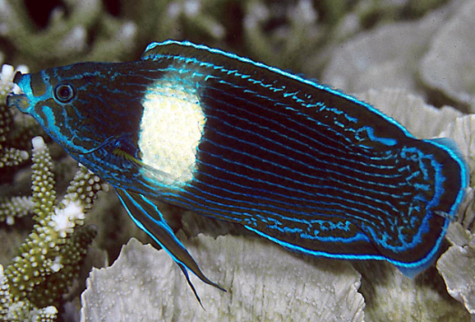

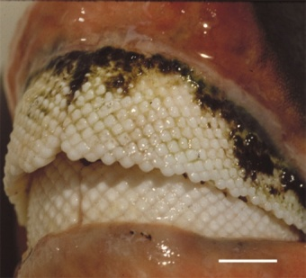
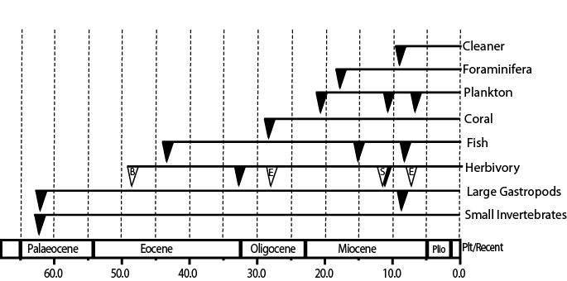

My
Cowman, Bellwood, van Herwerden (2009) MPE 52: 621-31
Notes:
Feeding mode Line Graph
Triangles = feeding mode in new lineage
Herbivory = General herbivory and herbivory within Parrot fished B, E, S
Multiple origins with no temporal concordance.
Four distinct patterns in this graph

Slide 19
7 Ma
Notes:
Feeding mode Line Graph
Triangles = feeding mode in new lineage
Herbivory = General herbivory and herbivory within Parrot fished B, E, S
Multiple origins with no temporal concordance.
Four distinct patterns in this graph

Slide 20
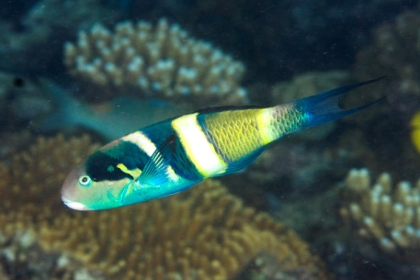
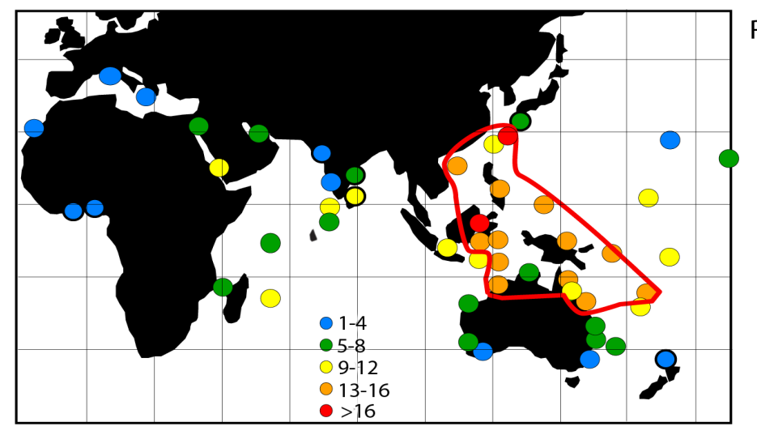
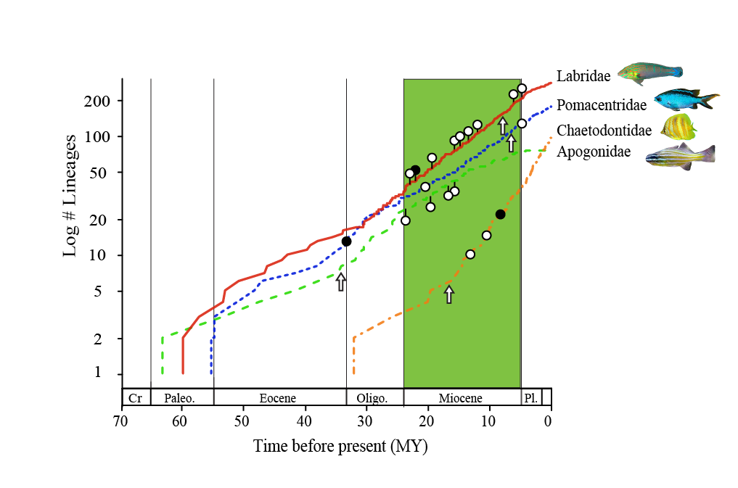
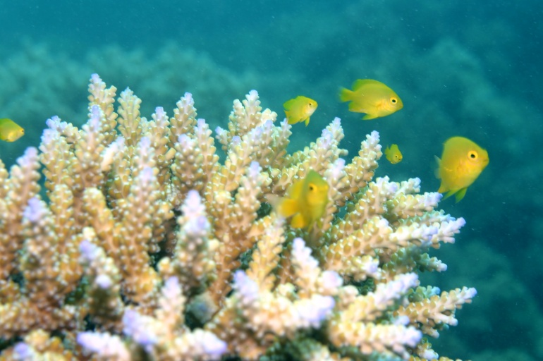
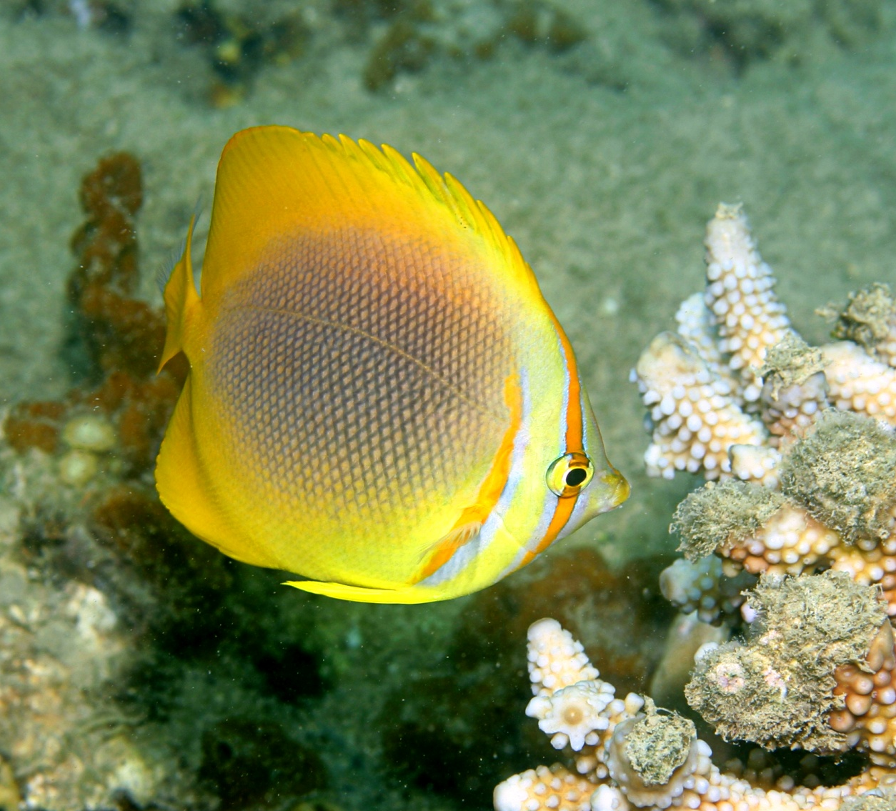
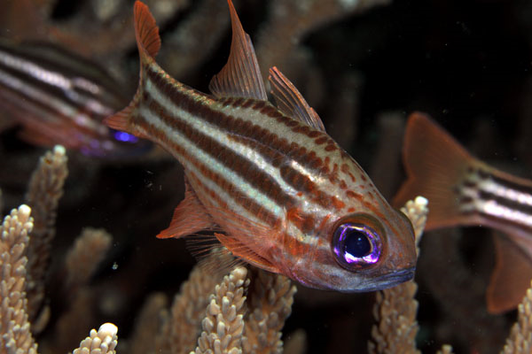
Cowman & Bellwood (2011) J. Evolutionary Biology

Slide 21

400 MY – Indifference
209 MY – First bite = benthic durophage
50 MY – Herbivory, nocturnal feeding
30-8 MY – Specialists – forams, coral feeders, etc
25-5 My – Tight association with corals
7 MY - Every major trophic mode

Slide 22



Middle Stone-Age humans
-Hunting on coral reefs
0.1 My
(125,000 years ago)
Jackson et al. (2001) Historical overfishing
and the recent collapse of costal ecosystems.

Slide 23

Have humans changed the roles of fishes on reefs?
Bellwood, Hoey & Hughes (2012), Proc R Soc 279:1621

Slide 24


Slide 25



Slide 26

Coral
predation
Bioerosion
Bellwood, Hoey & Hughes (2012), Proc R Soc 279:1621

Slide 27

Reports of declines in last 50 years..

Slide 28

New erosional environment not seen for 28 My

Slide 29




Slide 30






Slide 31




Slide 32





Bellwood et al. 2006 Global Change Biology

Slide 33




Live coral abundance 2m

Slide 34

Bellwood et al. 2012 Oecologia

Slide 36


Slide 37


Bellwood et al. 2012 Oecologia

Slide 38
Coral
predation
Area
grazed
Bioerosion
Sediment
removed

Slide 39
Coral
predation
Area
grazed
Bioerosion
Sediment
removed

Slide 40


Thanks to: The reef fish lab and colleagues in the CoE for helpful discussions
and J Krajewski, R Bonaldo, P Cowman, J Tanner, & J Cinner, for images.

